Slide 1
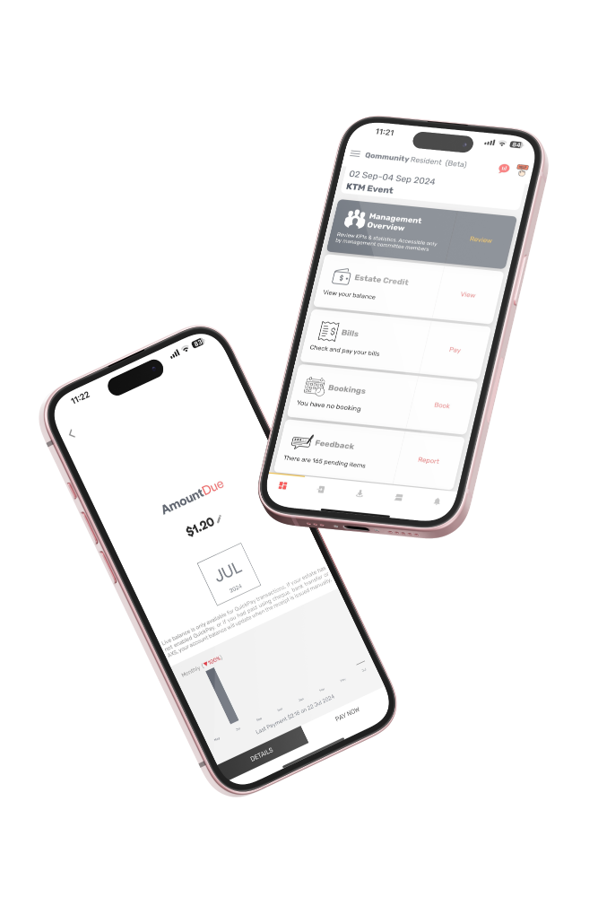
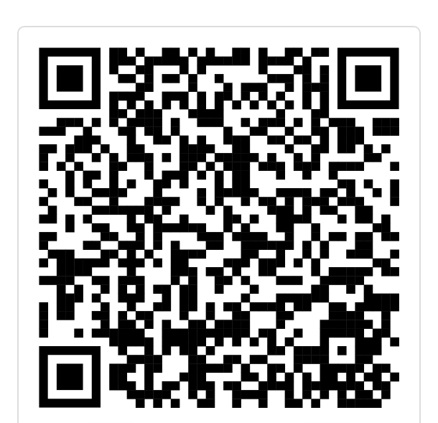
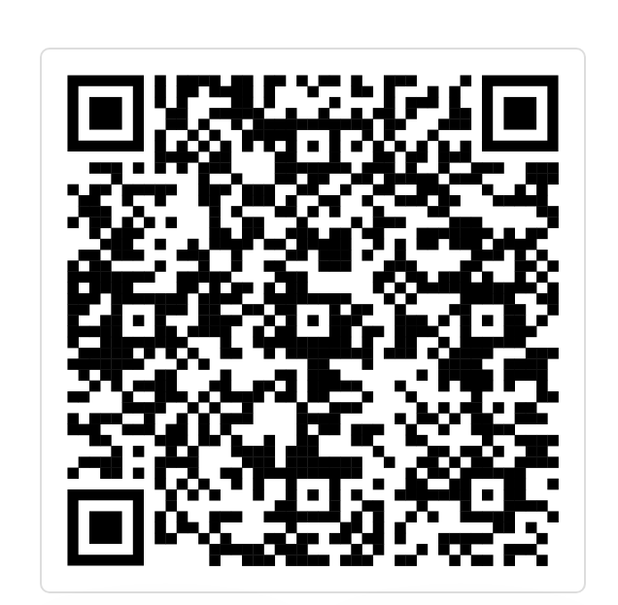
LAUNCHING SOON
QOMMUNITY RESIDENT
Book Facilities
View & Pay Bills
E-Applications
Feedback
Facility bookings
Others
PDPA-Compliant
GET CONNECTED.
DOWNLOAD QOMMUNITY NOW

